Slide 1
Machine Learning Project
Bryan W. Nonni & Frankie Sanchez

Slide 2
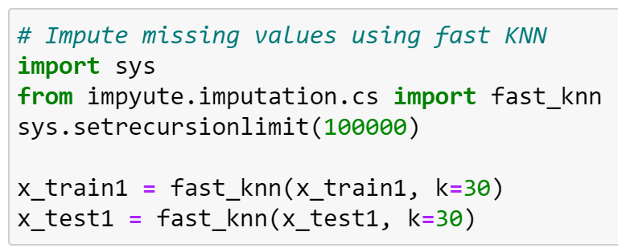
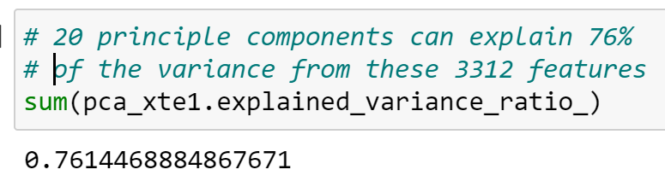
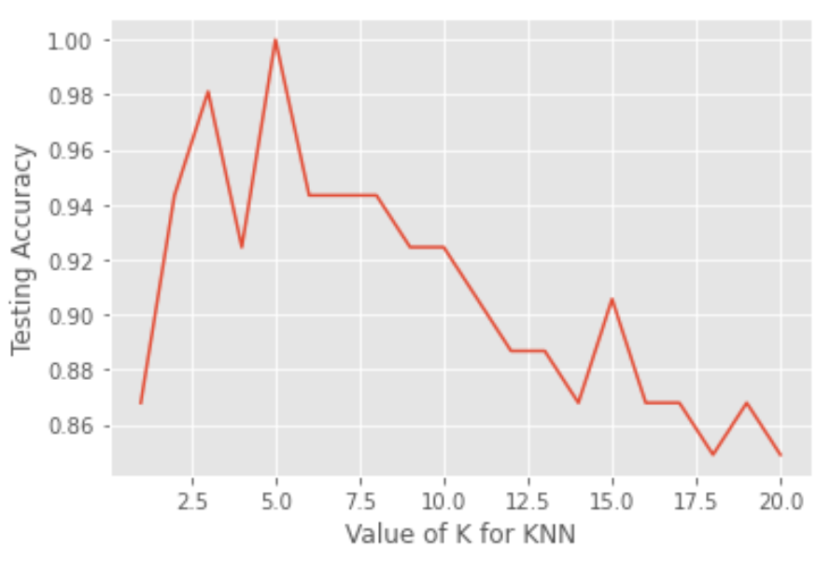
Multi-Class Classification
Process:
Clean/Preprocess Data Sets
Used KNN to imputate missing/bad data
Turned bad data into NaN values, then used fast KNN
Performed PCA for dimensionality reduction
E.g. Took training and testing set 1 from 3312 features to 20 most significant features
Removed columns that didn’t match both sets (down to 15 features)
Future: Test for new components c: 20 >= c >= 100, and retrain models for best c values
Goal: Reduce features to only most impactful on Y
Performed KNN (e.g. k = 5 for dataset 1) to predict missing class values
Trained multiple models using cleaned x_train and x_test
SVM, KNN, Random Forest, Logistic Regression, etc.

Slide 3
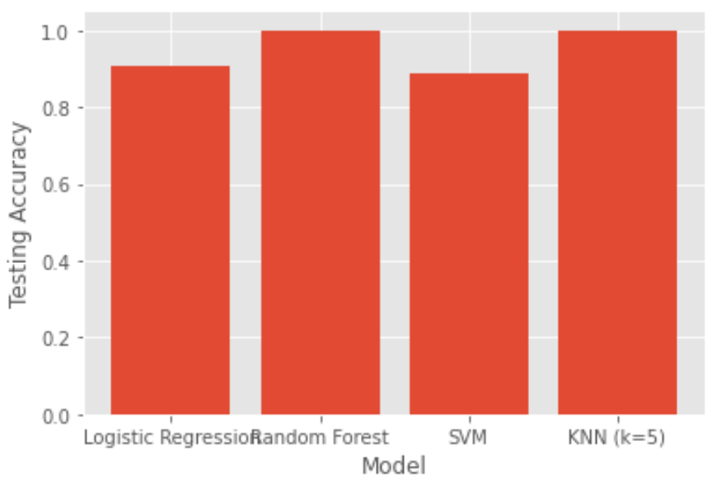
Multi-Class Classification
Partial results for data set 1:
Accuracy
Random Forest Classifier = 100%
Logistic Regression = 90.6%
SVM (SVC, kernel = linear) = 88.7%
KNN (k = 5) = 100%

Slide 4
Missing Value Estimation
Process:
Isolate a single missing value (i.e. 1.0000000000000001e+99)
Use this to find all missing values in datasets 1, 2 & 3
Replace with NaN using Pandas .replace() method
Use fast_knn to fill NaN values and cast to DataFrame

Slide 5
Still working through questions 3 and 4! Coming Soon!
Thanks!

